Slide 1

Anurag Bhatt

Slide 2
The journey so far
Founded in 1994
Term coined by Mr. Xerxes Desai : ‘Tan’ + ‘Nishq’
From 18K gold watches to 22K gold jewellery
Unorganized huge market
Blend of traditional values and modern outlook
1996 : Tanishq
2005 : GoldPlus
2008 : Zoya
2011 : Mia

Slide 3
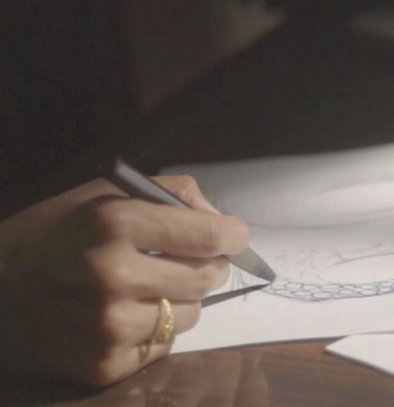
Brand philosophy
Quality : promise of purity and superiority of creations
Trust : TATA is trust
Innovation in design : blend of the tradition and modern

Slide 4
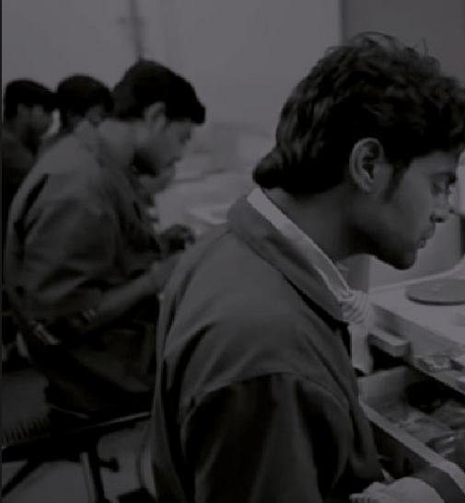
Karigars
Delight to all the workers and customers involved
world class facilities, safe and supportive environment, extra benefits
Training for and access to top of the line machines
13,000 sq ft facility in hosur

Slide 5

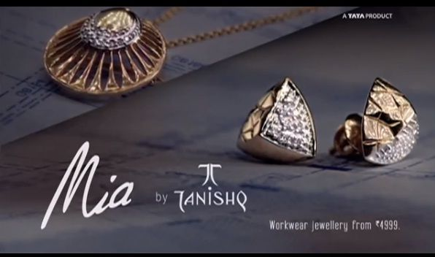

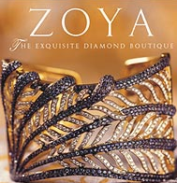
Range of products
Tanishq, gold plus, zoya, mia
Financial schemes - gold

Slide 6
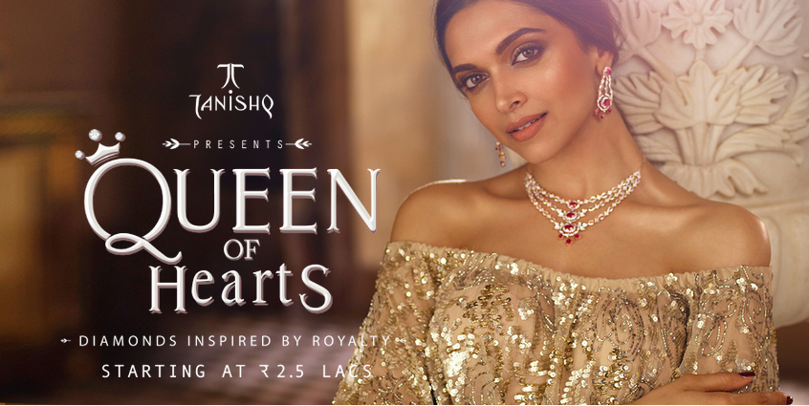
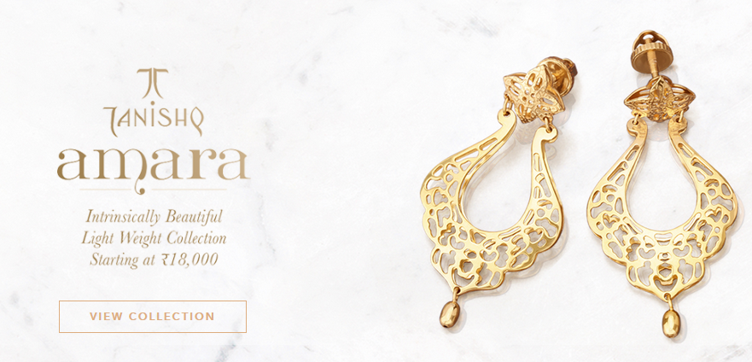

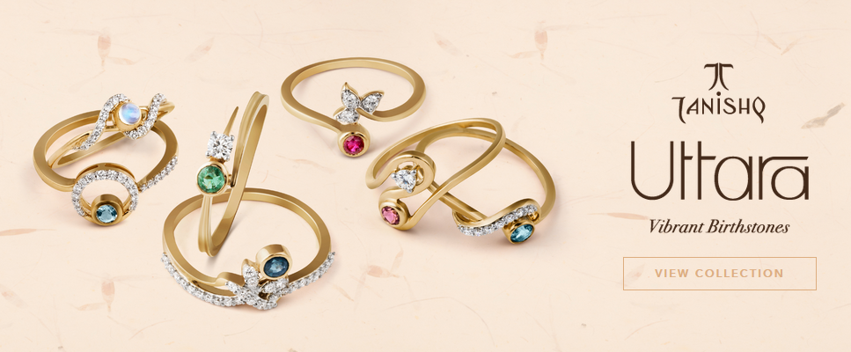

Slide 7


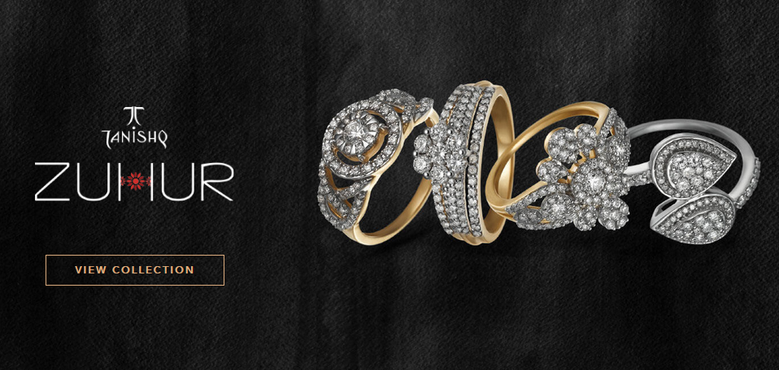


Slide 8


Slide 9
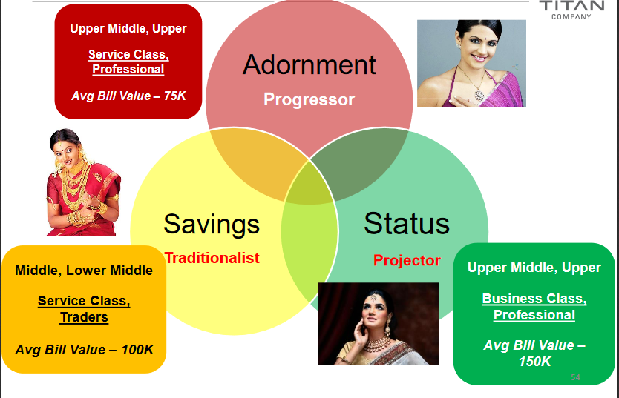
Customer profile

Slide 10






Competition and market share

Slide 11
Performance in past

Slide 13
Campaign design

Slide 14
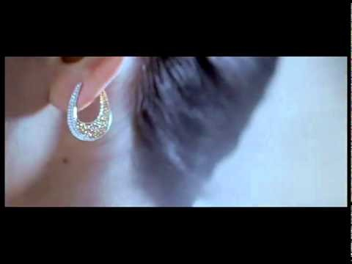
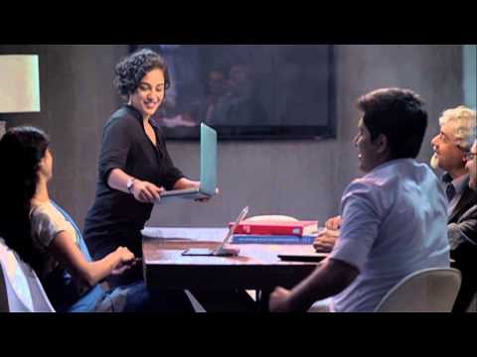
Past ads

Slide 15
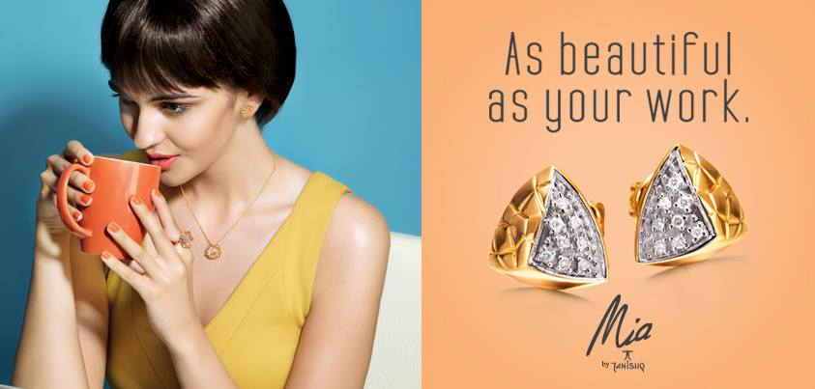

Slide 16
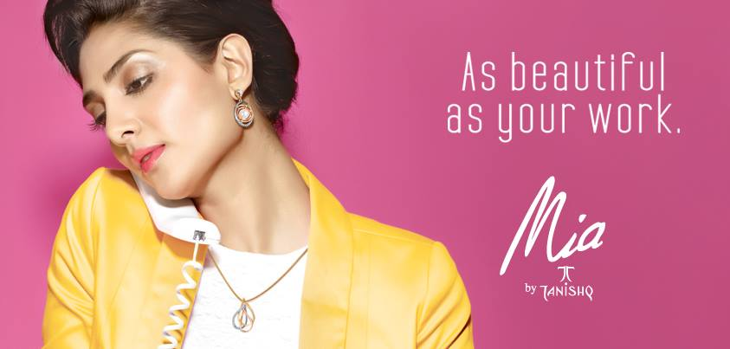

Slide 17
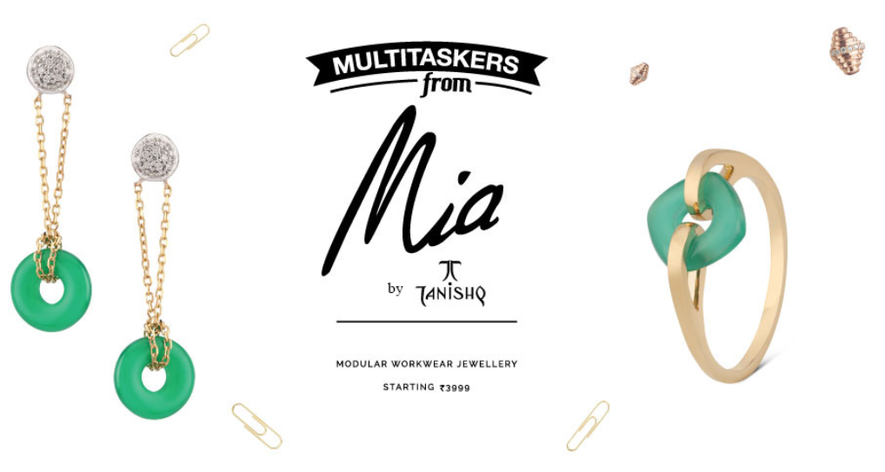

Slide 18
Campaign
ATL
BTL
TV ads
Bill boards
Newspapers
Personalized email
More expensive
expensive
expensive
inexpensive

Slide 19


Increase sales
Customer acquisition
Rewarding customers
O
B
J
E
C
T
I
V
E

Slide 20
Eligibility (for ATL)
No need of a strict eligibility criterion
Need to design the campaign for maximum penetration
Where to place the bill boards
When to air the ads
Sunday newspaper or Saturday newspaper

Slide 21
Eligibility (for BTL)
The hard-working woman
A working woman
A student
Age – 20-35
Encircle member
Has been a contributor – made purchases > 5k

Slide 22

Campaign message
Celebrating hard work
Celebrating the working woman
Rewarding yourself
You have earned it

Slide 23
The offer
Lucky draw
Reward points
Basic discounts
Free ear-rings / ring
10% of the purchase value
15% off on all purchases

Slide 24
Measuring success
Sales data
Use of Analytics
Email responsiveness
Number of new people added to loyalty program

Slide 25
Thank you

